Slide 1
Innovation project management course
Stage 4: Implementation
Barbora Dvořáková & Michal Pivko

Slide 2
Implementation
Project implementation
the plan designed in the prior stages of the project life is put into action
the activities described in the work plan are carried out
comprises the coordination of a wide range of activities
includes monitoring and controlling = measuring performance and taking corrective action to assure that the project is on track to meet its goals
and also risk management as unanticipated events and situations will inevitably occur
The purpose is to deliver the expected results
(deliverables and other direct outputs).

Slide 3
Implementation
Objectives
learn how to manage the project step by step at the stage of its implementation
introduce the individual topics that they may be encountered during the execution of the project
Learning Outcomes:
Knowledge and ability to work with
- project teams
- project budget
- project quality
- project risks
- deliverables and outputs

Slide 4
Implementation - Content
How to manage
PEOPLE - Managing the Project Team and Project Consortium
RESOURCES - Managing Budget
QUALITY - Monitoring Quality of Work and Prospective and Technology Watching
WORK - Monitoring of Project Performance and Progress
RISKS - Addressing Risks
OUTPUTS - Project Outputs and Acceptance of Project Implementation

Slide 5
Lets get started
Work plan ready and understood by all the actors involved
Resources - financial, material and human resources.
Actions need to be taken before work can begin:
Scheduling activities and identifying potential bottlenecks.
Communicating with the team and ensuring all the roles and responsibilities are understood.
Ensuring that the (financial) resources are available and distributed accordingly.
Providing for project management tools to coordinate the process.

Slide 6
MANAGE PEOPLE KICK-OFF MEETING
Briefing Team Members: Kick – off Meeting
The Implementation phase starts with the Kick-off Meeting.
The purpose is to formally start the project. Team members are introduced to the project.
The main aim of Kick-off Meeting is to:
ensure that everyone understands the project scope, their roles and responsibilities
clarify the expectations of all key project stakeholders,
identify and mitigate project risks,
discuss and agree on the project plans.

Slide 7
MANAGE PEOPLE MANAGING TEAM
Briefing Team Members: Managing Project Team
Project team = project manager and project staff who have been assigned with the responsibility to work on the project.
Innovation projects require a diverse mix of individuals who must be integrated into an effective project team.
Methods of Managing Project Team
Communication and supervision to track work and attitudes of project teams. By conversation and observation, the PM communicates with team members and reviews their achievements in the context of deliverables, accomplishments and interpersonal issues.
Performance appraisals allow measuring performance of project team members to clarify project team roles and responsibilities, review constructive feedback, discover unresolved issues, develop individual training programs, and outline specific goals for future project activities.
Conflict management to hande conflicts in a team environment to achieve higher productivity and positive working relationships.

Slide 8
MANAGE PEOPLE MANAGING CONSORTIUM
Briefing Team Members: Managing Project Consortium
Project Coordinator serves as the central contact point, leads and represents the consortium.
Project partners actively contribute to the project,have their own budget, roles and responsibilities.
Associated partners provide insight and information and support the project without the budget (end-users, industry, regional authorities,…)

Slide 9
MANAGE PEOPLE MANAGING CONSORTIUM
Briefing Team Members: Managing Project Consortium
A project (management) plan/manual/handbook
document that describes how the project will be executed, monitored, and controlled, and closed. It outlines the objectives and scope of the project and serves as an official point of reference for the project team, associated partners and stakeholders
Project agreements
Grant agreement = is the funding agreement concluded between the funding agency and the project participants and specifies the rights and obligations of the contracting parties
Consortium/partner agreement = private agreement between the beneficiaries, to set out the rights and obligations amongst themselves. (It does not involve the Funding Agency.) It addresses internal organisation and management of the consortium, IP provisions, and settlement of internal disputes.

Slide 10
MANAGE RESOURCES MANAGING BUDGET
Project Budget = detailed estimation of all costs needed to complete the project. It is continuously reviewed, revised, and updated.
The most common project cost categories are: personnel, travelling, consumables, services, subcontracting, equipment
Once the project budget has been reviewed and approved the next step is to create a budget baseline = a time-phased budget that project managers use to measure and monitor budget performance.
Budget Execution = the action of authorizing the expenses approved in the budget. The project manager then initiates to carry the activities that lead to hiring project staff, purchase of equipment, materials and services, all according to a project procurement plan.

Slide 11
MANAGE QUALITY MONITORING
QUALITY
Quality is degree to which the project fulfills requirements.
Project quality management = process through which quality is managed and maintained throughout a project.
Quality management processes
Internal = within the consortium (proofreading, presenations of outputs/activities+ feedback)
External = Advisory board, external experts´feedback
Project sponsor/grant provider = assessment, evaluation, recommendations for improvement
Quality plan Quality assurance Quality control

Slide 12
MANAGE WORK MONITORING OF PROJECT PROGRES
Monitoring of Project Performance and Progress - collecting information about the state of the project’s progress = tracking the project dimensions of scope, schedule, cost and quality, monitors risks, issues and project change, and forecasts their evolution using performance measures (KPIs or others)
Project Work Plan as a reference for monitoring project performance
Exchange information about the project’s current status and next steps with the Project Team
Monitor the progress of
Tasks/activities
Key outputs/deliverables and milestones achieved as planned.
Resource utilization - resources used as planned and costs as budgeted.
People—team morale, stakeholder engagement, overall project dynamics and productivity
Logs—the status and evolution of issues, changes and decisions.

Slide 13
MANAGE RISKS RISK ANALYSIS ASSESSMENT AND MITIGATION
A risk is anything that could potentially impact your project’s timeline, performance or budget. Risks can be technical, organizational, external, …. Risks are potentialities, if they become realities, then must be addressed.
Risk identification (repository, check list, experts, …)
Risk analysis (probability, impact)
Plan a risk-response strategy (action plans or strategies to reduce risks)
Act - Risk controlling-response activities (monitor and control the implementation of risk-response activities)

Slide 14
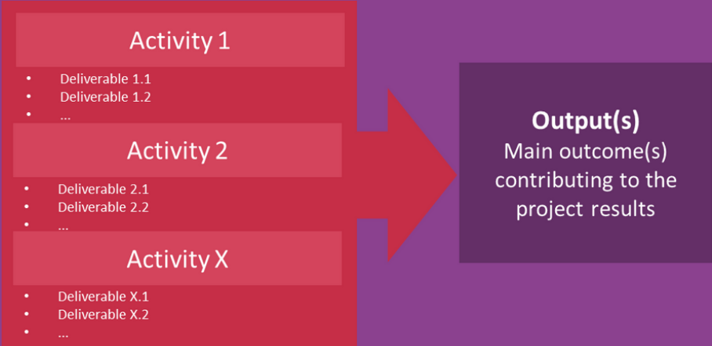
MANAGE OUTPUTS PROJECT
OUTPUTS´
APPROVAL
Project Outputs = results which are achieved immediately after implementing an activity. They are directly produced by the project, tangible and easy to measure
Project deliverable = a product or service of the project activity that contributes to the development of a project’s outputs.
A project may produce one or more deliverables and outputs. Each of them must be formally accepted. The acceptance process ensures that they meet the predefined objectives and criteria, so the project requestor can formally accept them.
A review and approval are recommended before the project can move to the next phase. It must be assessed that all the goals of the Implementation phase have been achieved and verified, all planned activities carried out, all requirements have been met, and that the project’s outputs have been fully delivered. Project Owner/fund provider has to accept the deliverables.

Slide 15
THANK YOU FOR YOUR ATTENTION

