Slide 1
Innovation Project Management Course
Stage 3: Design
Lukáš Melecký & Michaela Staníčková

Slide 2
Project Design: Description
Major step towards a successful project!
Strategic organisation of ideas, materials and processes to achieve project goal or objective, outcome and output.
One of the first responsibilities of the project manager for a given project.
Stage of the project cycle that includes collection of decisions about planning how to manage and govern a project in implementation stage.
A step by step point of view introduces a project plan in the view of a project triple constraints (scope – time – costs).

Slide 3
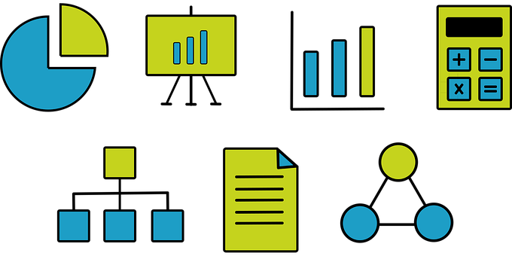
Project Design: Focus
Overall project description (Project plan).
Responsibilities for completing the project.
Project goals/objectives, outcomes and outputs.
Description of when all the project settings (goals, outcomes and outputs) will be reached.
Timeline of when the major deliverables, products or features will be completed.
Estimation of the project budget and outlines how to monitor and evaluate progress in the project.

Slide 4
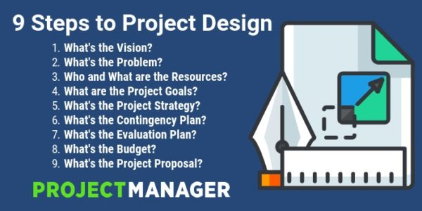
Project Design: Workflow
Source: Ray [online] (2018)

Slide 5
Scope of Work (SOW)
One of the most important documents to use when designing a project.
SOW makes sure that expectations are clear and agreed upon, and that all stakeholders know exactly what they are supposed to do.
An effective SOW should include project features like:
Project Objectives: What is it the issue that you face and what do you want to achieve with this project?
Schedule/Milestones: When does the project begin and by when does it need to be finished? What are the major milestones or phases of the project enabling you to track and measure progress?
Individual Tasks: What exactly needs to be done to from now onwards to finish the project?
Deliverables: What do you need at the end of the project?
Payment Information: How much is the project going to cost and how are you going to pay the team?
Expected Outcomes: The answer to your problem statement.
Terms, Conditions and Requirements: Define the terms that you use in the SOW and clarify any necessary conditions or requirements yet unclear.

Slide 6
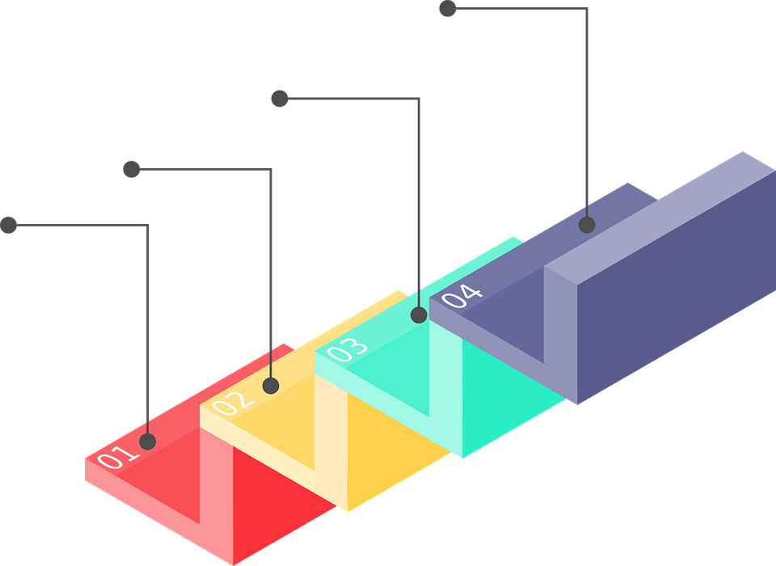
How to Design a Project?
Stage of Design Usually Includes:
Estimating project time and budget.
Milestones.
Scheduling.
Budgeting.
Resources.
Risk Assessment.
Communication.
Monitoring and Controlling.

Slide 7
Design Stage Features
Estimating project time and budget
A project must be ON – TIME and ON – BUDGET
Methods that can be used:
Task costs – break the project up into small tasks and assign costs.
Activity Durations – break the project into small tasks and assign activity duration.
Costs and Schedule – once the activity costs project schedule have been established, the project manager has to link the estimates so as to be able to arrive at approximate cash flow. The manager has to look at the activities that have been schedule and the costs assigned to each activity to schedule payments.

Slide 8
Design Stage Features
2. Milestones
A project milestone shows an important achievement in a project. The milestones should represent a clear sequence of events that incrementally build up until your project is complete.
Project milestones show how the project is advancing. They have zero duration because they symbolise an achievement or a point of time in a project.
Since a milestone’s start and end date depends on the start and end date of a task, task association is a major feature of a milestone.
3. Project Scheduling
Project scheduling is a mechanism to communicate what tasks need to get done and which organisational resources will be allocated to complete those tasks in what timeframe.
Graphs and diagrams that can be used:
Gantt chart, line graph, network diagrams based on the Critical Path Method (CPM) or Program Evaluation and Review Technique (PERT).

Slide 9
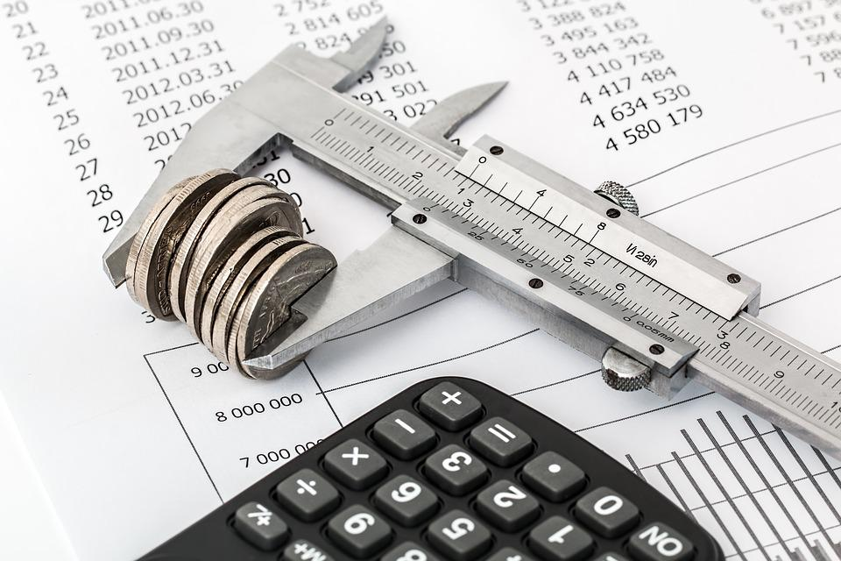
Design Stage Features
4. Budgeting
Project budgeting determines the total amount of financial resources allocated for the project to use.
The budget for a project is the combined costs of all activities, tasks and milestones that the project must fulfil.
Why is project budgeting important?
It’s an essential part of securing project funding.
A well-planned budget provides the basis for project cost control.
A project budget has a direct effect on the company’s financial viability.

Slide 10
Design Stage Features
5. Resources
Resources can be people, equipment, place, money or anything else that you need to do all of the activities that you planned for.
Every activity in your activity list needs to have resources assigned to it.
Resource availability includes information about what resources you can use on your project when they are available to you and the conditions of their availability.
Are our resources adequate and suitable?
The resource analysis is a strategic planning tool which considers:
Resources required to support particular strategies, and those needed to gain “competitive” advantage.
Required competencies to effectively use those resources.
Make a Resource Analysis.
Make a Resource Plan.

Slide 11
Design Stage Features
6. Risk Assessment
A risk is anything that could potentially impact your project’s timeline, performance or budget.
Risk assessment is a systematic process of identifying hazards and evaluating any associated risks within a workplace, then implementing reasonable control measures to remove or reduce them.
Project risk management is the process of identifying, analysing and then responding to any risk that arises over the life cycle of a project to help the project remain on track and meet its goal.
When and how can you improve your risk identification?
Early in the project.
In an iterative manner.
On a consistent frequency such as weekly.
When change control is performed.
When major milestones are reached.

Slide 12
Design Stage Features
7. Communication
The success of a project largely depends on the efficiency of its communication network.
Communication starts working from day one of the ventures and continues for the entire life span of the project.
Communication provides regular updates to notify the status of the project as well as its performance capacity.
How can be an effective communication achieved?
OBS
Hierarchical model describing the established organisational framework for project planning, resource management, time and expense tracking, cost allocation, revenue/profit reporting, and work management.
Groups together similar project activities or “work packages” and relates them to the organisation’s structure.
OBS is used to define the responsibilities for project management, cost reporting, billing, and budgeting and project control.
OBS helps to identify which employees or departments are responsible for completing specific tasks related to a project.
Make an Organisational Breakdown Structure (OBS).

Slide 13
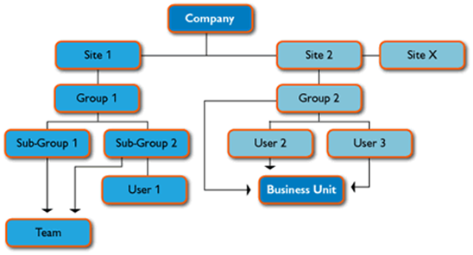
Design Stage Features
7. Communication
How OBS is developed:
Draw the entire organisation as a hierarchy.
Define of all departments and project teams.
Specify of functional (were cost for the work the user does is allocated to) and approval (who approves the work the user performs and any leave time approvals) groups for every user.
Project stakeholders in OBS:
Project Manager. 5. Business Analyst.
Project Team Member. 6. Advisory Board.
Project Sponsor. 7. Work Package Leader.
Executive Sponsor. 8. Task Leader.

Slide 14
Design Stage Features
7. Communication
Effective communication among project team members and stakeholders is important on any project team.
Miscommunication can create hard feelings that might remain undetected for a long time, undermining team success.
Open communication in all directions, without fear of reprisal, must be encouraged so that every team member feels comfortable contributing to discussions and debates.
Project debates are exceptionally useful because it is during these debates that team members provide useful and important information to others.
Improving communication involves identifying information needs and ways to best share information among the team.
Predictable and effective communication will help maintain trust and momentum. The team’s policies should provide an environment that assures that the information shared is valuable to the project.
Make a Communication Plan

Slide 15
Design Stage Features
8. Monitoring and Controlling
Monitoring and controlling activities check the existence of any deviations from the expected results of the project and continually track, review, adjust and report on the project’s performance.
Process of Project Monitoring and Controlling
Source: Project Management Qualification (2019)

Slide 16
Design Stage Features
8. Monitoring and Controlling
Project control processes mainly focused on:
Measuring planned performance vs actual performance.
Ongoing assessment of the project’s performance to identify any preventive or corrective actions needed.
Keeping accurate, timely information based on the project’s output and associated documentation.
Providing information that supports status updates, forecasting and measuring progress.
Delivering forecasts that update current costs and project schedule.
Monitoring the implementation of any approved changes or schedule amendments.

Slide 17
Design Stage Features
8. Monitoring and Controlling
Monitoring and control techniques:
A Requirements Traceability Matrix (RTM) - maps, or traces, the project’s requirements to the deliverables. This makes the project’s tasks more visible. It also prevents new tasks or requirements being added to the project without approval.
A control chart - monitors the project’s quality. There are two basic forms of control chart - univariate control chart displays one project characteristic, while multivariate chart displays more than one.
Review and status meetings - analyse problems, finding out why something happened. They can also highlight any issues that might happen later.

Slide 18
THANK YOU FOR YOUR ATTENTION

