Slide 1
Innovation project management course
Module 2: InnoPro Course Concept
Lukáš Melecký & Michaela Staníčková

Slide 2
InnoPro Course Concept
1. Theoretical Basis
InnoPro Course Concept Questions:
How to be innovative in teaching and training project management discipline?
What approach and project management methodology to use to make it interesting for teaching and training?
How to design the InnoPro course to fit all intellectual outputs materials (theoretical, practical, Moodle, …)?
SOLUTION: Project Cycle Management (PCM) Approach

Slide 3
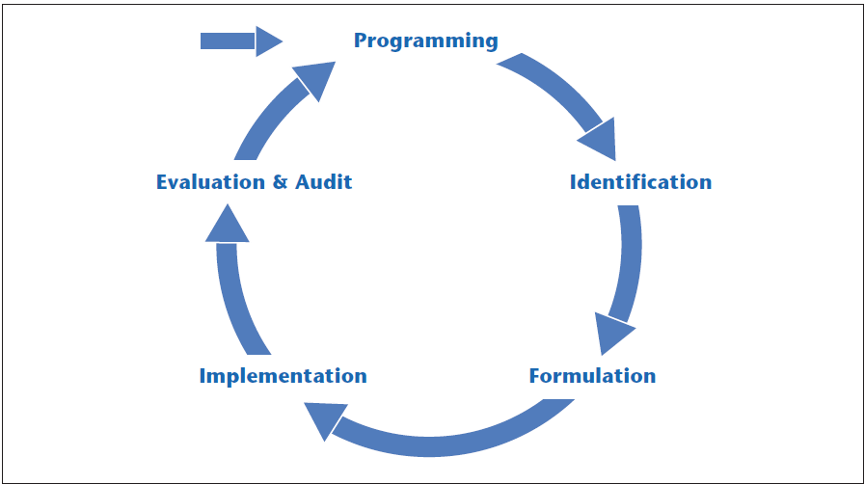
InnoPro Course Concept
1. Theoretical Basis
PCM: Approach for Searching an Appropriate Innovative PM Model
Project Cycle Management (PCM)
Project management approach that addresses the complexities of a project through all of its phases, while maintaining alignment with the strategy and objectives agreed upon by stakeholders at the onset.
Methodology for managing projects - it provides structure to the process, but also includes consulting stakeholders and providing them with relevant information throughout the life cycle of the project. This helps inform the best possible decisions.
The cycle of management operations within PCM is divided into five phases:
Programming.
Identification.
Formulation.
Implementation.
Evaluation & Audit.
Source: European Commission [online] (2004)

Slide 4
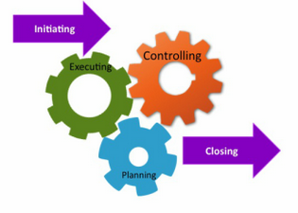
InnoPro Course Concept
2. Project Life Cycle Approach
IPEC Model / IPECC Model: Finding an Appropriate PM Model
‘Classic’ project management approaches based on the common methodology of the European Commission (Centre of Excellence in Project Management) → PM² Project Management Methodology.
IPEC project lifecycle model has four phases with a different type of activity predominant in each phase:
1. Initiating, 2. Planning, 3. Executing, 4. Closing.
IPECC project lifecycle model has five phase with different type of activity:
1. Initiating, 2. Planning, 3. Executing, 4. Closing, 5. Controlling.

Slide 5
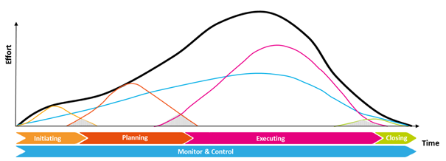
InnoPro Course Concept
2. Project Life Cycle Approach
IPECC Model: Finding an Appropriate PM Model
Project Lifecycle Phases based on PM² Project Management Methodology
Phase | Description
Initiating | Define the desired outcomes. Create a Business Case. Define the project scope. Get the project off to a good start.
Planning | Assign the Project Core Team. Elaborate on the project scope. Plan the work.
Executing | Coordinate the execution of project plans. Produce deliverables.
Closing | Coordinate formal acceptance of the project. Report on project performance. Capture Lessons Learned and post-project recommendations. Close the project administratively.
--- | ---
Monitoring and Controlling | Oversee all project work and management activities throughout the project: monitor project performance, measure progress, manage changes, address risks and issues, identify corrective actions etc.
Source: European Commission. Centre of Excellence in Project Management (2018)

Slide 6
InnoPro Course Concept
3. InnoPro course Concept Approach: AIDIC Model
InnoPro course PCM approach → from IPEC model to AIDIC model.
AIDIC Model: Stages
Assessment = Define the Problem.
Initiation = Develop Solution Options.
Design = Plan the Project.
Implementation = Execute the Plan.
Closure = Monitor, Control Progress, Close the Project.
AIDIC Model: PM methodology background
Project Management Institute (PMI) – The Project Management Body of Knowledge (PMBOK® Guide).
International Project Management Association (IPMA) – Individual Competence Baseline (ICB4.0).
European Commission Centre of Excellence in Project Management (CoEPM²) – PM² Project Management Methodology.
European Commission EuropeAid Cooperation Office (EuropeAID) – Project Cycle Management (PCM) Guidelines.

Slide 7
InnoPro Course Concept
4. AIDIC Model: Theoretical Basis
Stage 1: Assessment
Define the Problem: You need to identify the problem to be solved by the project. It helps to visualise the desired result. What will be different? What will you see, hear, taste, touch, or smell? What client’s need is being satisfied by the project?
Stage 2: Initiation
Develop Solution Options: How many different ways might you go about solving the problem? Brainstorm solution alternatives (you can do this alone or as a group). Of the available alternatives, which do you think will best solve the problem? Is it more or less costly than other suitable choices? Will it result in a complete or only a partial fix?
Stage 3: Design
Plan the Project: Planning is answering questions: what must be done, by whom, for how much, how, when, and so on? Naturally, answering these questions often requires a crystal ball.
Stage 4: Implementation
Execute the Plan: Once the plan has been drafted, it must be implemented. Interestingly, we sometimes find people making a great deal of effort to put together a plan, then failing to follow it. If a plan is not followed, there is not much point in planning, is there?
Stage 5: Closure
Monitor, Control Progress & Close the Project: Plans are developed so that you can achieve your result successfully. Unless progress is monitored, you cannot be sure you will succeed. It would be like having a road map to a destination but not monitoring the highway signs along the way.

Slide 8
InnoPro Course Concept
5. AIDIC Model: Breakdown and Structure
STAGE | GENERAL DESCRIPTION | SUB-STAGE | STEPS | PROJECT OUTPUTS | TOOLS and TEMPLATES
ASSESSMENT | The organization defines needs and commissions the project to meet it | Assessment of the problem, need or opportunity to start a project Innovation opportunities analysis | Formalisation of problem, need or opportunity to start a project Innovation prospective | Project Initiation Request (PIR) Innovation project report | Tools: PIR Form Templates: Mindtools.com
INITIATION | The tasks required to authorize, fund and define the project, generally on the organizational level (above the project) | Project identification and definition Initial project budget allocation Primary project stakeholder’s identification Fundraising | Project Purpose Project Goals/Questions Project Scope Project Deliverables Project Stakeholders Grant Resources Instruments for financing innovations Public procurements | Project Initiation Plan Project Charter Project Scope Statement Stakeholder Analysis Grant Resources Analysis | Tools: Mind Map Logical Framework Matrix (LFM) Project Charter Template Grant Resources Analysis Templates: Coggle.it Carleton.ca Easyproject.com Smarthseet.com Vertex42.com Logframer.eu
DESIGN | The project management team define how the project will be carried out, who will do the work, how long it will take, and so forth The planning phase defines the project in sufficient detail that all stakeholders’ expectations are understood | Creating of workflow project Estimating project time and budget Gathering resources Risk assessment Project communication Monitoring & Controlling | Scope of Work Project Milestones Project Scheduling Project Budgeting Resource Plan Identification and management of project risks Communication requirements and rules Monitoring of project performance and progress, managing changes, addressing risks | Statement of Work Gantt Chart Project Plan (Success Factors, Deliverables, Schedule, Budget, Human resource, Quality management) Risk management plan Procurement management plan Project status report and project change documentation | Tools: Work Breakdown Structure Organisation Breakdown Structure Responsibility Assignment Matrix Gantt Chart Cost Breakdown Structure Resource Breakdown Structure Risk Assessment Tool Communication Matrix Templates: Easyproject.com Smarthseet.com Vertex42.com
Source: Author`s elaboration (2020)

Slide 9
InnoPro Course Concept
5. AIDIC Model: Breakdown and Structure
STAGE | GENERAL DESCRIPTION | SUB-STAGE | STEPS | PROJECT OUTPUTS | TOOLS and TEMPLATES
IMPLEMENTATION | The project work is completed and the final product or service is achieved while secondary stakeholder requirements are satisfied Concurrent to the project work the project management team monitors and controls all aspects of the project – schedule, cost, stakeholder’s requirements, etc. If problems are encountered, changes to the project plan are made | Briefing team members Monitoring quality of work Validity and up-to-date innovations Managing budget and earned value Monitoring & Controlling | Kick-off meeting Project status Change request Prospective and technology watching Project outputs handovers Acceptance of project implementation Monitoring of project performance and progress, managing changes, addressing risks | Kick-off meeting minutes (agenda) Project status report Status updates and project change documentation Stakeholder communication Earned value analysis (EVA) Project checklist Technology watching report and business plan | Tools: Kick-off Meeting Template EVA Template Project Checklist Template Change Management Document Template Progress Project Report Template Business plan template Templates: Easyproject.com Smarthseet.com Vertex42.com
CLOSURE | The project has completed its product or service, and the necessary documentation and administrative work must be done to close the project Exploitation of results | Project reporting Analysing project and team results Project documentation closure Project evaluation Intellectual and industrial property aspects Monitoring & Controlling | Public Procurement procedures evaluation Instruments of industrial and intellectual property protection Final beneficiary and subsidy provider acceptance Project archiving Lessons learned Monitoring of sustainability of project outputs, managing changes, addressing risks | Project checklist Patents, utility models and/or industrial design Project final report Accounting report Project sustainability report | Tools: Final Project Report Template Templates: Easyproject.com Smarthseet.com Vertex42.com
Source: Author`s elaboration (2020)

Slide 10
THANK YOU FOR YOUR ATTENTION

